Slide 1
CIS 4930/6930-002 Data Visualization
VISUAL ENCODING
Paul Rosen
Assistant Professor
University of South Florida
slides credits Miriah Meyer (U of Utah)

Slide 2
Visual Encoding
marks and channels
planar position
time
color

Slide 3

MARKS
graphical element in an image
classified according to number of spatial dimensions required
points (0D)
lines (1D)
areas (2D)

Slide 4

marks
marks as nodes (items)
points (0D)
lines (1D)
areas (2D)
marks as links
containment
connection

Slide 5
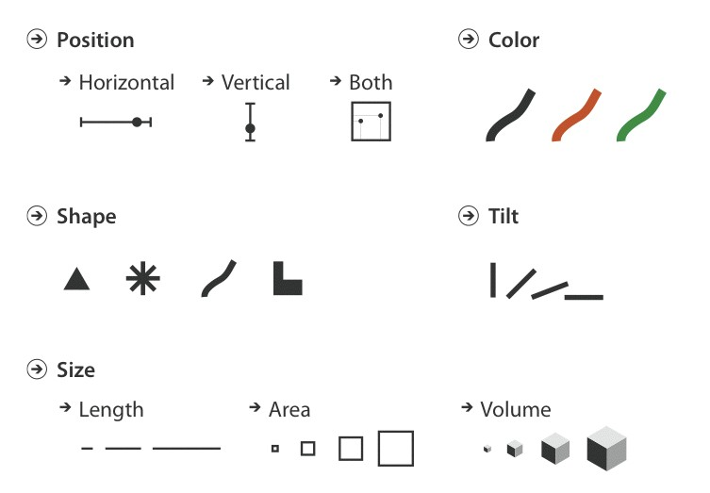
CHANNELS
parameters that control the appearance of marks

Slide 6
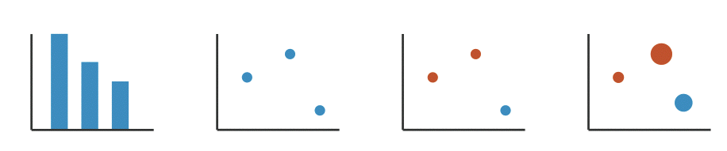
name that mark and channel

Slide 7
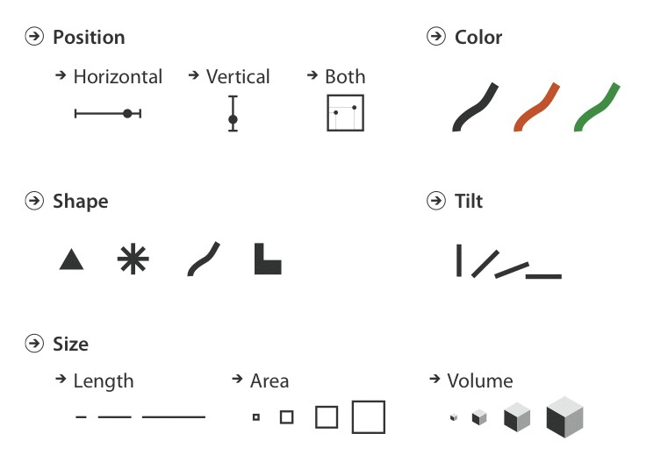
CHANNEL TYPES
identity (what or where)
magnitude (how much)

Slide 8
expressiveness & effectiveness

Slide 9
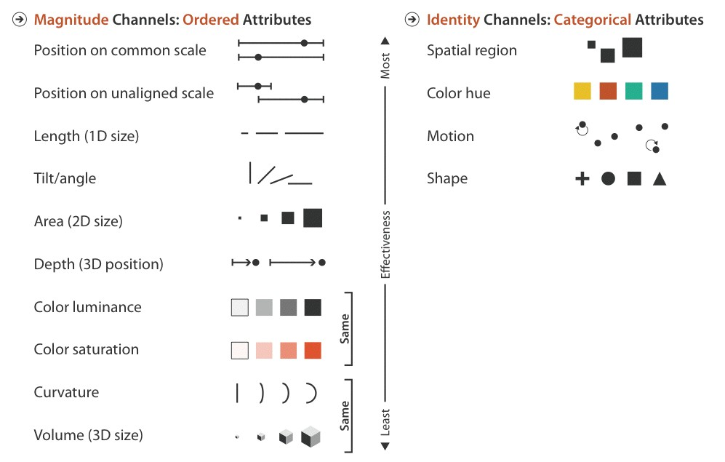
expressiveness
(what or where)
(how much)

Slide 10
effectiveness

Slide 11
WHERE DO RANKINGS COME FROM?

Slide 12
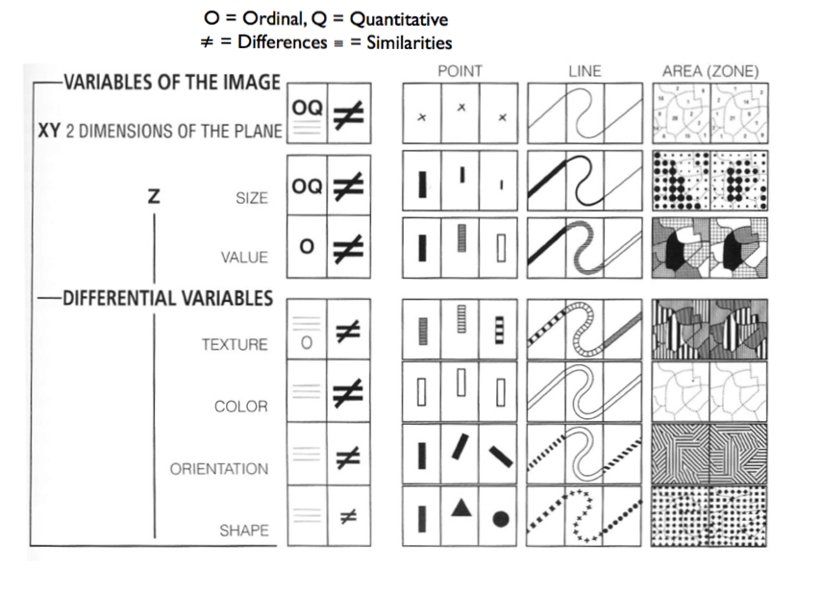
Bertin, “Semiology of Graphics”, 1967

Slide 13
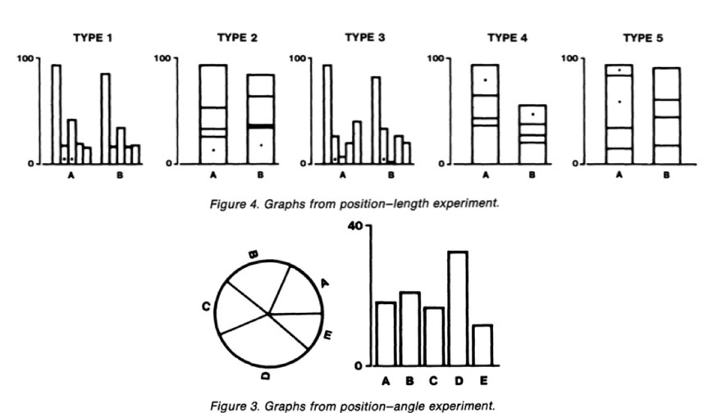
Cleveland & McGill, “Graphical Perception and Graphical Methods for Analyzing Scientific Data”, 1985

Slide 14
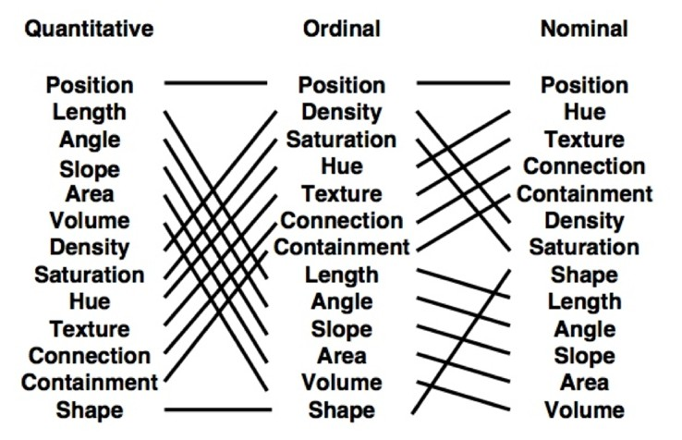
Mackinlay, “Automating the Design of Graphical Presentations of Relational Information”, 1986

Slide 15
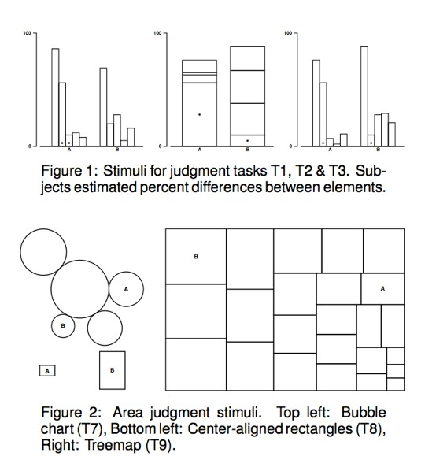
Heer & Bostock, “Crowdsourcing Graphical Perception: Using Mechanical Turk to Assess Visualization Design”, 2010

Slide 16
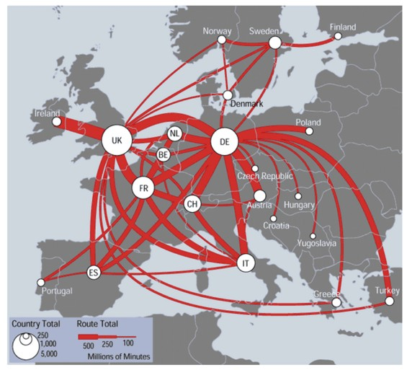
DISCRIMINABILITY
can channel differences be discerned?

Slide 17
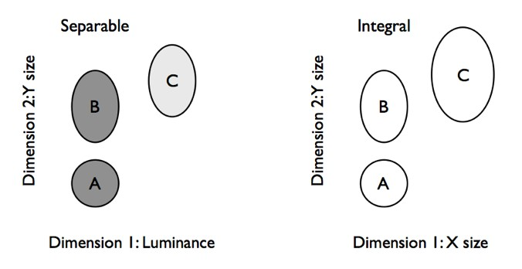
SEPARABLE vs INTEGRAL
separable: can judge each channel individually
integral: two channels are viewed holistically
separable integral
Ware 2004

Slide 18
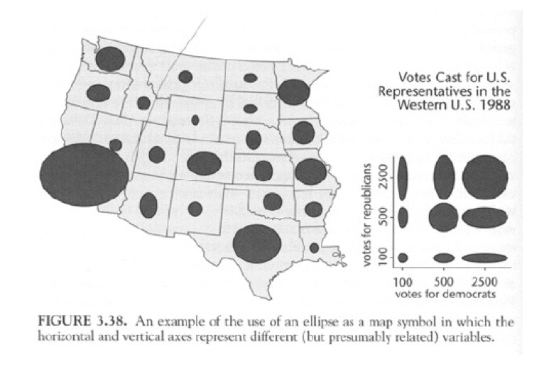
SEPARABLE vs INTEGRAL
MacEachren 1995

Slide 19
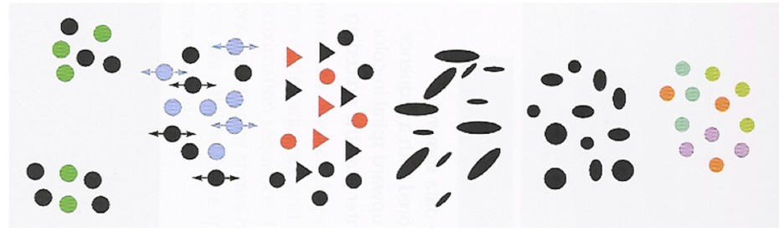
SEPARABLE vs INTEGRAL
separable
integral
color | location
color | shape color | motion
x-size | y-size
red-green | yellow-blue
size | orientation
Ware 2004

Slide 20
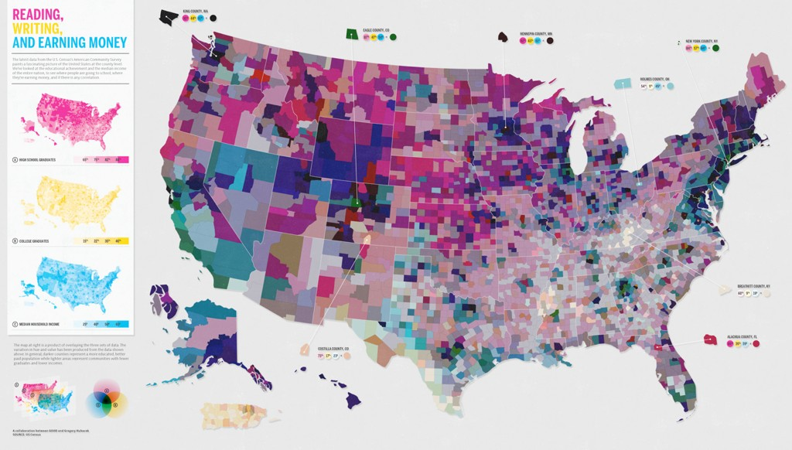
http://www.good.is/post/america-s-richest-counties-and-best-educated-counties/

Slide 21
From: http://www.columnfivemedia.com/wp-content/uploads/2017/12/7-best-infographic-design-2017..gif

Slide 22
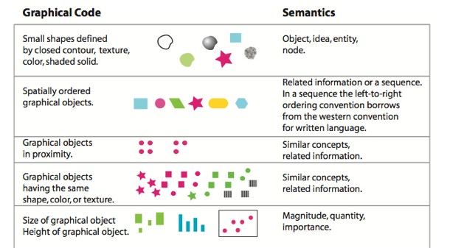
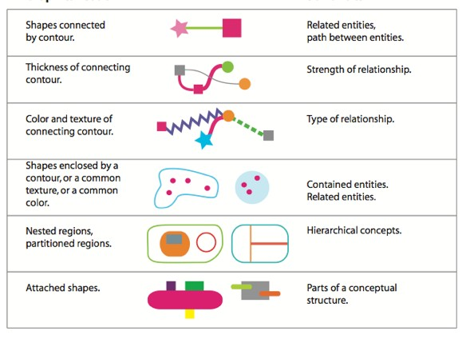
Encoding semantics
Ware 2010

Slide 23
+ perceptual effects we will discuss next lecture
pop-out
steven’s power law
weber’s law
gestalt principles

Slide 24
planar position
what‘s so special about the plane?

Slide 26
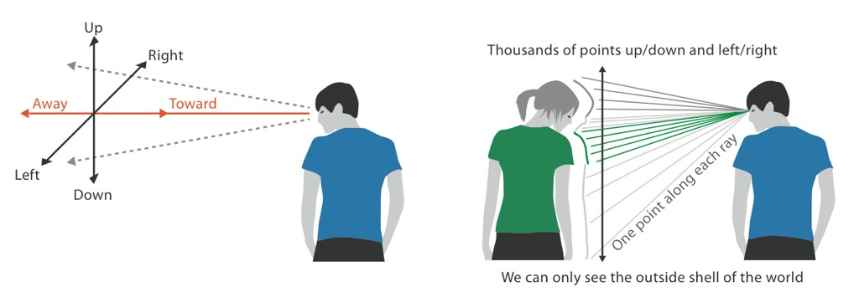
2.05D
we see the world as a 2.5D space

Slide 27
power does not extend to 3D
perspective cues
interfere with color and size channels
occlusion of data
text legibility

Slide 28
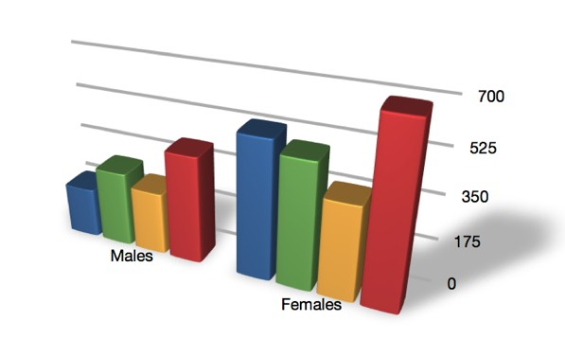
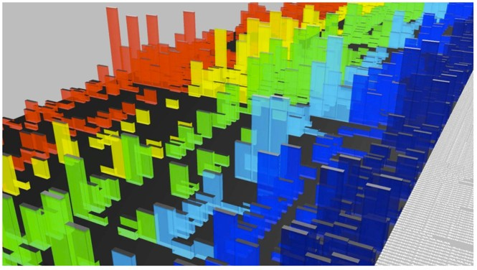
Moore 2011

Slide 29
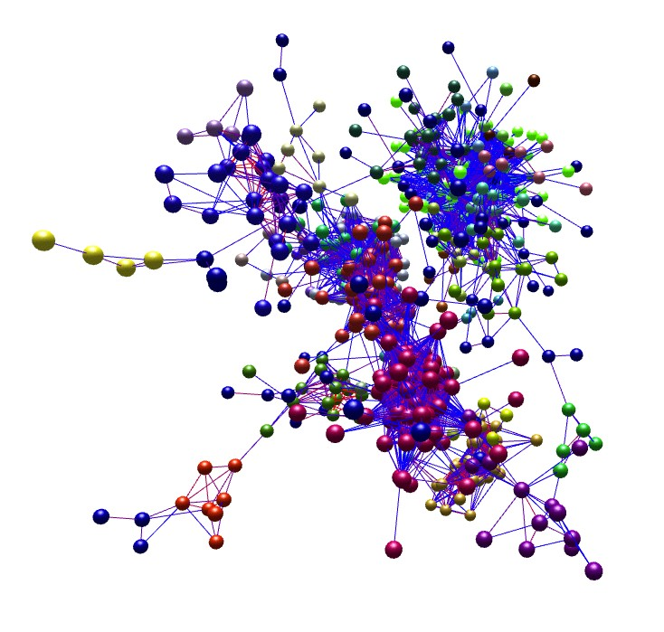
http://www.biolayout.org/

Slide 30
TIME AS ENCODING CHANNEL
You’ll remember, visualization uses pictures to enhance working memory
external versus internal memory
easy to compare views by moving eyes
hard to compare view to memory of what you saw

Slide 31
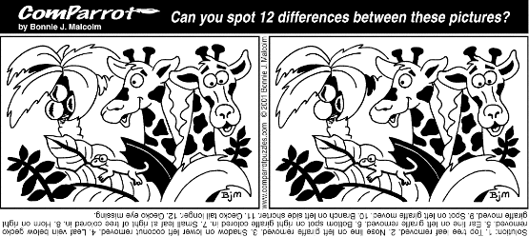

Slide 34
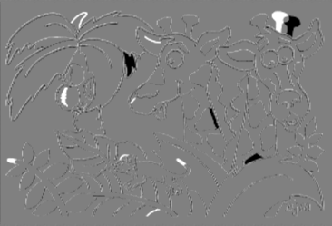

Slide 35
WHEN TO USE ANIMATION?

Slide 36
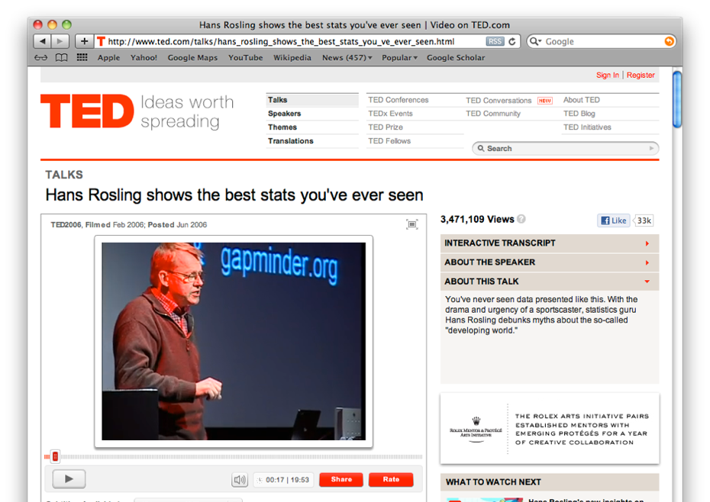
GOOD: STORYTELLING

Slide 37
GOOD: TRANSITIONS

Slide 38
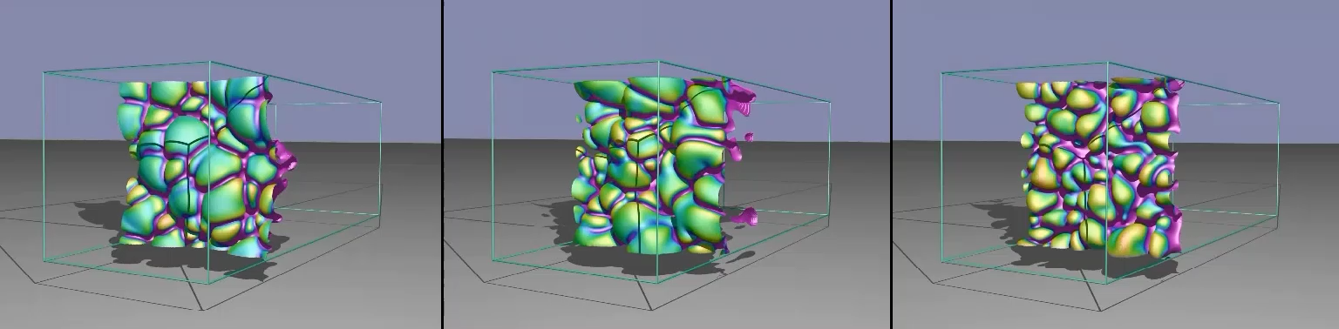
BAD: COMPARING COMPLEX STATE CHANGES OVER TIME
Comparing the Topology of Combustion Simulations, From the SCI Institute

Slide 39
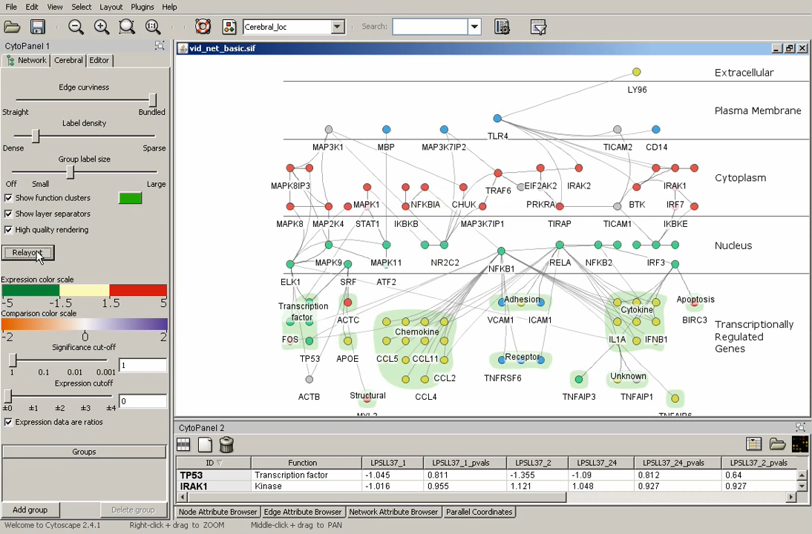
BAD: MULTIPLE STATES WITH MULTIPLE CHANGES

Slide 40
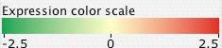
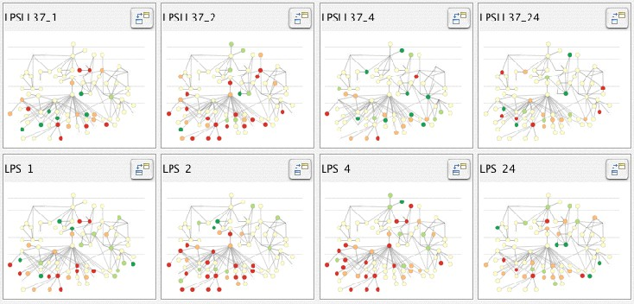
BAD: MULTIPLE STATES WITH MULTIPLE CHANGES
alternative: small multiples

Slide 41
Color will be discussed in next lecture
However, a good mantra is: “Get it right in black and white” – Maureen Stone

Slide 42
Recommended Reading
Visualization Analysis & Design: Chapter 2 (pp. 20-41) & Chapter 5 (pp. 94-115)

